Slide 1
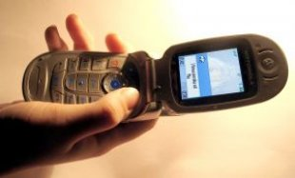

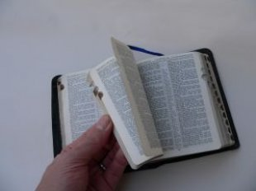

Mobile Discipleship
By John Edmiston

Slide 2

The Last Mile…
CHALLENGE: How to get training out to isolated rural learners and to Christian leaders in the new massive urban slums?
The mobile phone is one of the few viable delivery platforms
50-70% penetration rate even in Africa
Most will not have 3G data plans so we have to be creative
Need to combine the delivery mechanism (mobile) with small groups / mentoring / a respected discipler of people

Slide 3
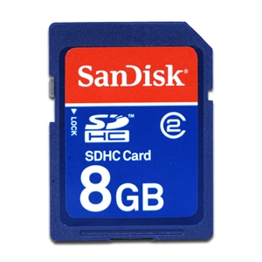
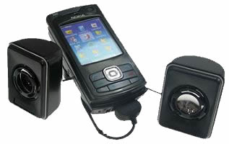
The Mobile
Bible College
Curriculum on an SDHC card
A mobile phone + speakers
Does not need reliable electricity
Does not require Internet access
Portable, secure and looks normal
Can train up to 25 people
Useful for house churches
Works with most types of phones
SDHC cards: 8Gb will hold up to 500+ hours of reasonable quality audio
30 hrs lecturing = one bible college subject (with some class discussion of the material)
So therefore 500 hrs = 16 subjects = 4 semesters of 4 subjects = 2 year course on a fingernail-sized chip

Slide 4
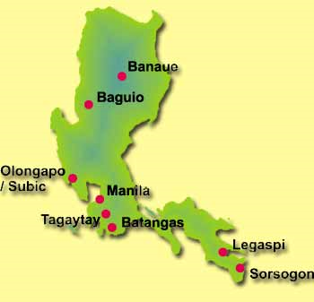
In Luzon
200+ pastors in a network
Use to learn Christology and apologetics to refute Muslims and a local cult (Iglesia Ni Cristo)
Ten minute segments
Scenario based learning
Discuss scenario in groups
Short quizzes
Emphasis on changing behavior
Both audio and video
Also a PDF textbook
Train facilitators who then train others.

Slide 5
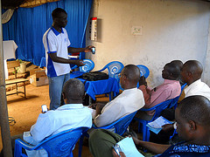
Other Models
A mobile learning app:
http://Allogy.com
Contains all the audio, video and text needed for a course, quizzes by SMS, final assessment pen and paper. Learn at own pace.
The app as used in Africa
http://technology.ccci.org/projects/the-mlearning-project/

Slide 6
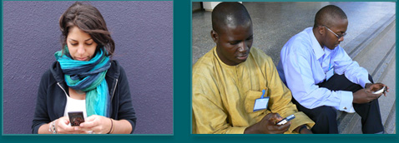
Using SMS To…..
Make or follow-up a decision for Christ
Ask life-changing questions
Get student feedback
Indicate “homework” to be done
Send brief content such as bible verses
6 brief messages a day can start changing someone’s life..
Gammu SMS gateway (free)
Text Magic (email to SMS)
Frontline SMS (SMS to a large group of people anywhere there is a mobile signal)

Slide 7

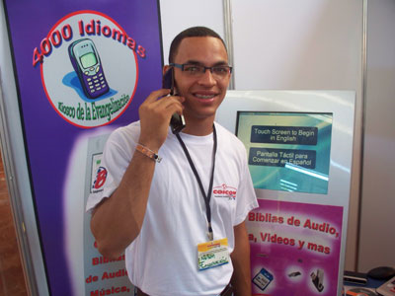
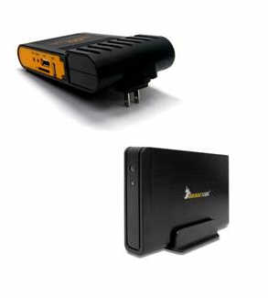
Mobile Evangelism Kiosks
Model A) Physical kiosk with SD card duplication capabilities
Model B) A 2TB HDD loaded with content plus a PlugPC and wireless router so gospel can be downloaded directly to phones. Highly mobile, does not require an Internet connection, can even be used on buses etc.
Audio bibles in numerous languages as well as key teaching materials - http://www.kioskevangelism.com/
Being developed by Stephen Keel in Virginia with assistance from Lightsys, MAF-LT, ICCM, GRN, and Cybermissions

Slide 8


Orality
Use mobile phones to reach oral learners – up to 70% of the population are primarly oral learners
Put audio bibles on SDHC cards or on .mobi websites
Listen to the bible stories in a group (using a mobile phone w. speakers etc.) and discuss.
Use with Way of Righteousness and other oral storying materials being developed
http://www.visualstorynetwork.org/

Slide 9
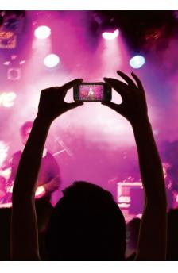
Creating Contextualized Content
Collect indigenous Christian music, sermons, teaching and stories using mobile phone video and audio recording and note-taking capabilities
Upload to a website or online repository, add metadata then make searchable
Duplicate collections (say in a particular language) e.g. on SD cards
Share via Bluetooth

Slide 10

Best Practices Mobile Media
Mobile Media Best Practices Working Document (in-process)- http://bit.ly/hKtyZ1
Shooting & Producing Good Video (General)- http://www.mobileadvance.org/how-to/84-how-to-3-producing-great-video-four-free-video-based-sites-that-will-get-you-there
Media for the Mobile Screen Best Practices- http://www.mobileadvance.org/how-to/88-how-to-4-top-10-mobile-video-production-tips
Shooting Good Video with a Mobile Phone- http://www.mobileadvance.org/how-to/96-how-to-5-shooting-good-video-with-a-mobile-phone
The above links are courtesy of MobileAdvance.Org

Slide 11

Course Design 1 – B4 U Start
Who: Are you trying to teach?
Who: Are they connected to?
Where: Are they? Bandwidth? Phones?
When: Time constraints & opportunities
What: Are their learning needs?
What: Are their felt needs?
What: Technology is available & easy?
How: Do they learn best?
How: Can they use the materials?
How: Can you tell if learning occurred?
How: Can you get feedback?
Why: Is there a real need or is it just cool?

Slide 12

Course Design 2 - Delivery
Smartphone App – high end users with 3g connections
SD Cards – basic feature phones, most computers and tablets
Wireless – many feature phones, laptops, ipods, tablets.
Bluetooth – limited range and file size, more advanced phones
Mobile website – feature phones and smartphones but cost of downloading materials may be high
Asterix audio call2phone – calls the phones or phones call Asterix server
Skype / conferencing – for phones w. Skype.

Slide 13
Course Design 3 – Choosing Media
Audio – universal, easy to make
Video – high cost of production
Ebook – needs to be a supported format on the phones, PDF on most
SMS – great for feedback
Story and Reflect – oral learners
Blended - have media on phone discuss in face-to-face group

Slide 14

Course Design 4 – Training Intervals
Shorter is better
No one wants to watch a 45 minute sermon on a 2 inch screen.
Ten minute “chunks” then reflect, feedback, SMS quiz etc.
Simple interface, not busy
Use scenarios that teach lessons create questions - like some management training videos
Interrupt-able – no devastating loss of info if the person has to glance away for a second.

Slide 15

About Cybermissions….
Cybermissions vision is to be changing people, churches and nations for good through online theological education and ministry training.
Cybermissions equips indigenous Christian leaders with the tools for evangelism, discipleship, church-planting, pastoral work and missions.
We also offer training in Internet Evangelism and Cybermissions
Our websites are:
www.globalchristians.org (Theological Education)
www.cybermissions.org (Cybermissions Training)
ww.newtestamentprayer.org (Prayer)
ww.eternityradio.org (Audio Bible Teaching)
www.biblicaleq.com (Counseling, EQ, Leadership)
CEO: John Edmiston
Ph: +1-310-549-6791
Fax: +1-310-834-2898
Cybermissions
E. Realty St.
Carson CA 90745
johned@aibi.ph

