Slide 1
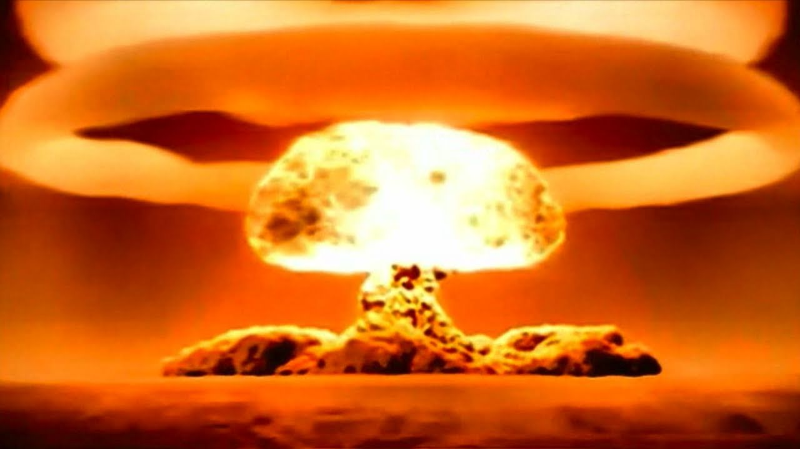
Technology and The End Times
John Edmiston
ICCM 2014

Slide 2
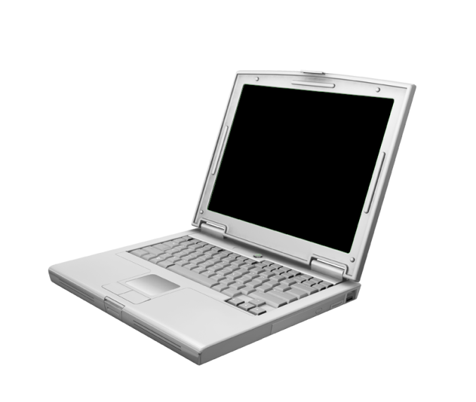
Technology: Current Challenges
Information overload
Pornography addiction
The ‘always connected’ youth
People who live their whole life playing video games or who dwell in a virtual reality world
Satanic online games / role playing
“Church” on Facebook / Internet
Cult recruitment online , false doctrine online
Privacy issues, scams,
Internet dating & cyberspace contribution to marriage breakdown

Slide 3

Possible Issues in 2025…
How do you share Christ with a genetically engineered human clone?
How do you even get people to a church building when they can “do a church service” in a powerful virtual reality environment
A world full of people who are hyper-sexualized from childhood and have ready access to powerful sexual stimuli
How do you share Christ in a world of universal surveillance?

Slide 4

Good Technology
The first Spirit-filled person in the Bible was a craftsman – Bezalel who built the Ark of the Covenant (Ex. 31 & 36)
Jesus was a carpenter and so using tools and creating objects must not be sinful.
Ezekiel’s vision of God dwelling above “the wheels” of a huge spiritual machine “for the spirit of the living beings was in the wheels” (Ezek. 1)
Good craftsmanship is always praised in the Bible because God gives wisdom and diligence to people so they can apply it.
Technology can be used for good purposes such as construction, medicine, crisis relief etc.
Good technology blesses people and glorifies God “that they may have life and have it more abundantly”

Slide 5
Evil Technology
However technology often arises out of rebellion e.g. Cain’s descendants who became inventors and technologists.
Evil technology includes instruments of torture, idols, massive images of dictators, and things created to deceive and enslave people. “The thief comes to steal, kill and destroy”.
Ancient temples often had tricks to make the idol appear alive
Evil technology creates fear and dominance and denies the existence of the Creator God so people worship the creature rather than the Creator.

Slide 6
Anti-Christ as a Technocrat
He will not regard the God of his fathers, nor the desire of women, nor regard any god. For he shall magnify himself above all. But in his place he shall honor the god of forces; and a god whom his fathers did not know, he shall honor with gold and silver, and with precious stones and desirable things. So he shall act in the fortresses of the strongholds with a strange god, whom he shall acknowledge. He shall multiply in glory, and he shall cause them to rule over many, and shall divide the land for a price. (Daniel 11:37-39)

Slide 7
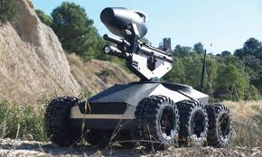
The Image of The Beast
The image of the Beast – “given breath” (artificial intelligence) able to speak (artificial speech) and able to kill all who do not worship it (a weaponized robot).
And there was given to it to give a spirit to the image of the beast, so that the image of the beast might both speak, and might cause as many as would not worship the image of the beast to be killed. (Revelation 13:15)

Slide 8

The Mark of the Beast
And it causes all, both small and great, rich and poor, free and bond, to receive a mark on their right hand, or in their foreheads, even that not any might buy or sell except those having the mark, or the name of the beast, or the number of its name. (Revelation 13:16-17)
RFID tags or similar biologically implanted ID combined with powerful databases and a fully digital financial transactions system capable of real-time identification of all buyers and sellers.
Financial transaction systems are only activated in the presence of the “mark” which involves renouncing Christ to receive it.

Slide 9

The Power Of The Beast
And they worshipped the dragon who gave authority to the Beast; and they worshipped the Beast, saying, "Who is like the beast? Who is able to make war with him?“ (Revelation 13:4)
Then I saw another beast coming up out of the earth, and he had two horns like a lamb and he spoke like a dragon….And he does great signs, so that he even makes fire come down from heaven on the earth before men. (Revelation 13:11-13)
Overpowering technology of war, plus the ability to do fake miracles and acts of stunning public power, probably via technology.

Slide 10

Big Data
Beyond enterprise-scale data to Internet-scale data and Hadoop super-computing clusters
Ubiquitous sensors and information streams providing real-time tactical data and real-time analysis down to the individual level with prediction of individual decisions.
Intersection of scientific high-performance computing and massive databases.
Can become overwhelmingly complex and is extremely difficult to manage well, so successful Big Data implementations can only be done by large corporations and by governments – which is NOT a level playing field for the average citizen.

Slide 11

Genetic Engineering
Henry Ford: Mass production and interchangeable parts.
Genetic Engineering 1 – Interchangeable parts, 3D printed organs, identical cattle, identical plants and crops
Genetic Engineering 2 - Mass production of individuals with “ideal” genes, removal of those with “defective” genes
Genetic Engineering 3 – Man becomes machine, enhanced capabilities, implanted processors.
Genetic Engineering 4 – Memories uploaded into databases and computers, parts replaced as they wear out, “eternal life”.

Slide 12

Racing With The Machine - 1
Taxis – replaced by driverless cars
Translators – replaced by software
Soldiers – replaced by drones and robots
Clerical Work – replaced by scanners, context-aware robots and information systems that can anticipate and decide
Basic Medical Examinations – replaced by sensors, computers and context-aware databases.

Slide 13

Racing With The Machine - 2
Spiritual and highly personal interactions will most likely not be replaced in the near future.
Most complex physical tasks such as hairdressing and gardening, most trades
Caring, child-care, elder care
Outdoor work especially with animals
Intuitive and artistic occupations

Slide 14
Privacy
Is privacy just an historical anomaly? Didn’t we all used to live “in each other’s pockets” back in the day?
Privacy is critical to the proper formation of personal identity and the maintaining of personal boundaries.
The question is not so much “how much do others know” but “how much do those with the power to hurt us know” – e.g. credit rating agencies?”
How much can the enemies of the gospel get to know about us and if so what use can they put it to?

Slide 15
God and Privacy
Does God respect human privacy in His omniscience?
Is the attempt at government omniscience a kind of hubris, an attempt at “being like God”?
What happens when churches “know too much” (cults!)
Is it OK for Christian parents to spy on their kids?
Is it OK for Christian employers to spy on their staff?
“In God we trust, everyone else we verify?”
How is electronic privacy related to faith?

Slide 16
Are All Wizards Evil?
(A Little Bit of Tolkein….)
Any sufficiently advanced technology is indistinguishable from magic. (Arthur C. Clarke)
Are there good wizards and bad wizards e.g. Gandalf vs Saruman or is all “wizardry” evil? Is Google a “good wizard” and Monsanto an “evil wizard”?
Does technology “cast a spell” on its users? Is it beginning to create an alternative spiritual universe of amazing blessings without God?
“The Shire” represents the Great Balance of Things in the created order. How disruptive to God’s order can technology become?

Slide 17
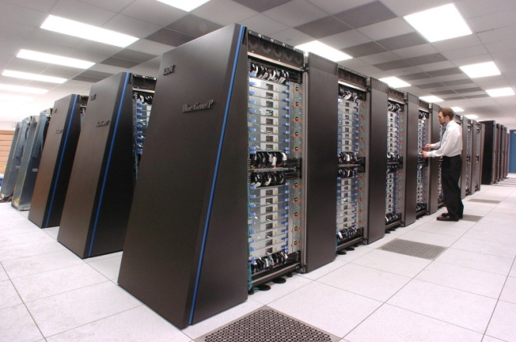
Technology and Idolatry
The rest of mankind, who were not killed by these plagues, did not repent of the works of their hands nor give up worshiping demons and idols of gold and silver and bronze and stone and wood, which cannot see or hear or walk, nor did they repent of their murders or their sorceries or their sexual immorality or their thefts. (Revelation 9:20-21)
There is a human tendency to attribute divine power to human creations. For some, this includes technology.
As technology become more and more pervasive and overpowering this may well increase.

Slide 18

Corporatized Government
Technology is creating cultural and economic pressures and security risks that require a rate of response well beyond that of current means of governance.
Corporate structures such as multi-national corporations, massive almost autonomous government agencies, defense contractors and very large NGOs are taking up the slack.
Government is so far behind that it is merely enacting legislation at the behest of these entities. The government is now simply the administrative arm of fast, highly responsive special interest groups e.g. Google getting legislation through on driverless cars. Government no longer governs.

Slide 19
Technocratic Oligarchies
https://www.princeton.edu/~mgilens/Gilens%20homepage%20materials/Gilens%20and%20Page/Gilens%20and%20Page%202014-Testing%20Theories%203-7-14.pdf
Multivariate analysis indicates that economic elites and organized groups representing business interests have substantial independent impacts on U.S. government policy, while average citizens and mass-based interest groups have little or no independent influence. The results provide substantial support for theories of Economic Elite Domination and for theories of Biased Pluralism, but not for theories of Majoritarian Electoral Democracy or Majoritarian Pluralism.
Martin Gilens and Benjamin I. Page: Testing Theories of American Politics: Elites, Interest Groups, and Average Citizens

Slide 20
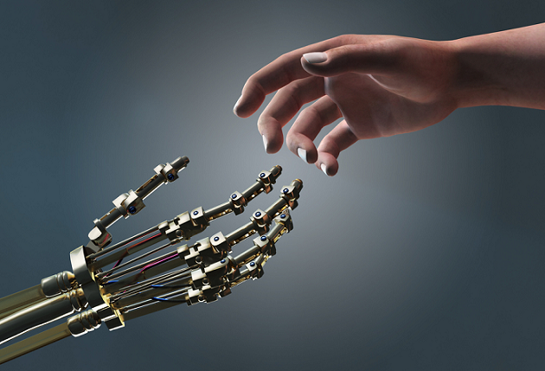
Transhumanism and Posthumanism
Transhumanism: the belief or theory that the human race can evolve beyond its current physical and mental limitations, especially by means of science and technology.
According to transhumanist thinkers, a posthuman is a hypothetical future being "whose basic capacities so radically exceed those of present humans as to be no longer unambiguously human by our current standards.“
However true Christian transhumanism is found when we receive our eternal and spiritual bodies at the resurrection which is our hope of going “beyond this mortal flesh”

Slide 21
People As Products
People are no longer Creations, they are products: products of heredity and environment, of the military, of the education system, of a certain college, of a set of traumatic experiences or certain set of privileges and so on.
Products can be improved, tested for quality and modified
Products are bought and sold in the Market for a value
They also have a shelf-life and can be discarded
Inferior product lines can be terminated.
There is no intrinsic value in a product e,g. how valuable is an iPad 2 today? This is a total contradiction of the gospel…..

Slide 22

Rescuing The Image of God
Humanity was created as incarnate spiritual beings in the image and likeness of God with enduring and eternal personal qualities and a with a deep need for justice.
The image of God will be fully revealed in us at the resurrection, at the “revealing of the sons of God” when we will “be like Him”. True transcendence comes through faith in Jesus Christ!
Ultimately technology will be shown as a futile hope.
Christian ministry needs to focus on developing the image of God in people and not on “producing results” or products.

Slide 23

Finding The Real God
And I saw another angel flying in mid-heaven, having the everlasting gospel to preach to those dwelling on the earth, even to every nation and kindred and tongue and people, saying with a great voice, Fear God and give glory to Him! For the hour of His judgment has come. And worship Him who made the heaven and the earth, and the sea, and the fountains of waters. And another angel followed, saying, The great city, Babylon, has fallen, has fallen; because of the wine of the anger of her fornication; she has made all nations to drink.
(Revelation 14:6-8)

Slide 24

Building God’s Kingdom - Digitally
www.cybermissions.org
www.globalchristians.org
www.newtestamentprayer.com
www.biblicaleq.com
21615 Berendo Ave. (Ste. 400)
Torrance, CA 90502 USA
+1-310-844-6948 (Google Voice)
johned@cybermissions.org (Email)
@Cybermissions (Twitter)
Cybermissions Prayer List, just send a blank email to:
Cybermissions-subscribe@yahoogroups.com

