Slide 1


Theology of Technology
Biola Digital 2014
John Edmiston
God and The High-Speed,
High Diversity Future

Slide 2

Connections
Everyone To Everyone
Everything to Everything (Internet of Things)
Ideas to Other Ideas
Values to Contrary Values
Cultures to Completely Different Cultures
God To Humankind

Slide 3

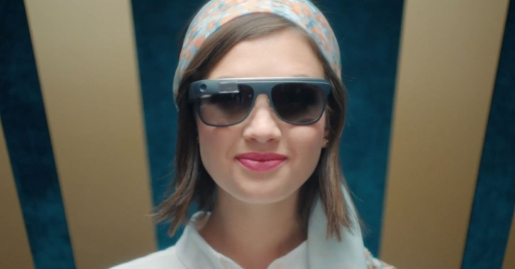
Contexts
Contextual Data and Contextual Search
There Is No Information Without Location
Google Glass and Context-Aware Technology
A World Full of Sensors
Omniscient Machines
You Are Your Data Points

Slide 4

Big Data
Beyond enterprise-scale data to Internet-scale data and Hadoop super-computing clusters
Ubiquitous sensors and information streams providing real-time tactical data and real-time analysis down to the individual level with prediction of individual decisions.
Intersection of scientific high-performance computing and massive databases.
Can become overwhelmingly complex and is extremely difficult to manage well, so successful Big Data implementations can only be done by large corporations and by governments – which is NOT a level playing field for the average citizen.

Slide 5

Genetic Engineering
Henry Ford: Mass production and interchangeable parts.
Genetic Engineering 1 – Interchangeable parts, 3D printed organs, identical cattle, identical plants and crops
Genetic Engineering 2 - Mass production of individuals with “ideal” genes, removal of those with “defective” genes
Genetic Engineering 3 – Man becomes machine, enhanced capabilities, implanted processors.
Genetic Engineering 4 – Memories uploaded into databases and computers, parts replaced as they wear out, “eternal life”.

Slide 6

Racing With The Machine - 1
Taxis – replaced by driverless cars
Translators – replaced by software
Soldiers – replaced by drones and robots
Clerical Work – replaced by scanners, context-aware robots and information systems that can anticipate and decide
Basic Medical Examinations – replaced by sensors, computers and context-aware databases.

Slide 7

Racing With The Machine - 2
Spiritual and highly personal interactions will most likely not be replaced in the near future.
Most complex physical tasks such as hairdressing and gardening, most trades
Caring, child-care, elder care
Outdoor work especially with animals
Intuitive and artistic occupations

Slide 8
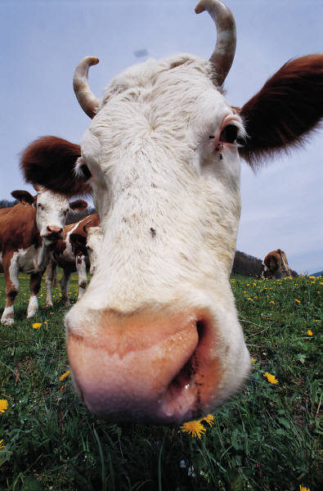
Coding and Ranching
You can’t eat computer code, so someone has to grow food and raise sheep and cattle.
We are becoming increasingly isolated from plants and animals and from agriculture, and from the seasons and cycles of nature.
The virtual world so dominates that we consume pictures of things instead of the “thing” itself. We now fear that which is real.
This results in alienation from the Creator God of the Bible, as well as a vast urban-rural split and terms like “fly-over country”.

Slide 9

Technology & Diversity
Cultures and values change very slowly
But technology demands rapid change
Technology makes us immediately aware of other cultures, values and religions and catalyzes cultural offenses and conflicts.
Technology often removes the social context and makes “in-house” and private comments seem very inflammatory.
The collision of diversity and technology is stretching human tolerance to a breaking point and creating radicalized, offended and alienated individuals and sub-cultures.

Slide 10
The Bacon Double-Cheeseburger
The bacon offends Jews, Muslims, Hindus and Seventh-Day Adventists
The beef offends the Hindus and most Buddhists
The cheese offends vegans, the lactose-intolerant and the Europeans who loathe American cheese
Having beef and cheese together offends Orthodox Jews
The bun offends the gluten-free advocates
The calories offend Jenny Craig
And Catholics won’t eat them on Fridays

Slide 11
Private and Public Spaces
Where can I safely eat my bacon double cheeseburger?
At home
In the restaurant
Not in a mosque
What about in public?
What about an Instagram picture of it?
What about a YouTube video of it?
When am I being insensitive?
When is my critic being invasive or immature?
What about my rights?

Slide 12

The Gospel, Technology and Diversity
Where can we proclaim a potentially offensive Christian gospel?
The gospel critiques all cultures with the “offense of the Cross”
Paul ALWAYS obtained permission prior to proclamation
How do we “get permission” when we use technology?
How is an “in-church” comment not a “public” comment when the church service is on YouTube?
How does technology increase BOTH the reach of the gospel and reaction to the gospel?

Slide 13
Privacy
Is privacy just an historical anomaly? Didn’t we all used to live “in each other’s pockets” back in the day?
Privacy is critical to the proper formation of personal identity and the maintaining of personal boundaries.
The question is not so much “how much do others know” but “how much do those with the power to hurt us know” – e.g. credit rating agencies?”
How much can the enemies of the gospel get to know about us and if so what use can they put it to?

Slide 14
God and Privacy
Does God respect human privacy in His omniscience?
Is the attempt at government omniscience a kind of hubris, an attempt at “being like God”?
What happens when churches “know too much” (cults!)
Is it OK for Christian parents to spy on their kids?
Is it OK for Christian employers to spy on their staff?
“In God we trust, everyone else we verify?”
How is electronic privacy related to faith?

Slide 15
Giving Away Privacy
Services like SnapChat are encouraging people to give away the most private moments of their lives, and often while intoxicated or immature.
This is incredibly spiritually destructive
We are faced with the question of how to redeem lost privacy? How does a pastor minister to someone whose photo is now all around the church, youth group or city?
Laws about what to do about photos and the “right to be forgotten” are now essential.

Slide 16
Are All Wizards Evil?
(A Little Bit of Tolkein….)
Any sufficiently advanced technology is indistinguishable from magic. (Arthur C. Clarke)
Are there good wizards and bad wizards e.g. Gandalf vs Saruman or is all “wizardry” evil? Is Google a “good wizard” and Monsanto an “evil wizard”?
Does technology “cast a spell” on its users? Is it beginning to create an alternative spiritual universe of amazing blessings without God?
“The Shire” represents the Great Balance of Things in the created order. How disruptive to God’s order can technology become?

Slide 17
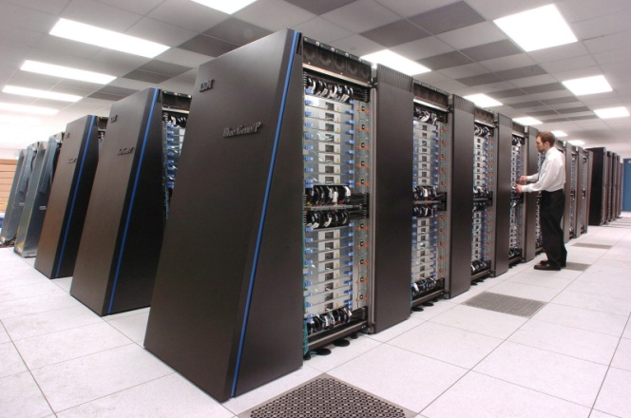
Technology and Idolatry
The rest of mankind, who were not killed by these plagues, did not repent of the works of their hands nor give up worshiping demons and idols of gold and silver and bronze and stone and wood, which cannot see or hear or walk, nor did they repent of their murders or their sorceries or their sexual immorality or their thefts. (Revelation 9:20-21)
There is a human tendency to attribute divine power to human creations. For some, this includes technology.
As technology become more and more pervasive and overpowering this may well increase.

Slide 18

#YesAllWomen
On the other hand technology can give a voice to the righteous or to those not being heard.
Technology can be put into service for Christian social justice and on behalf of the mistreated.
Hashtag activism is better than zero activism
In a high-speed, high diversity world we need to make our case, over-and-over-and-over again.
This includes the case for Christianity

Slide 19

Corporatized Government
Technology is creating cultural and economic pressures and security risks that require a rate of response well beyond that of current means of governance.
Corporate structures such as multi-national corporations, massive almost autonomous government agencies, defense contractors and very large NGOs are taking up the slack.
Government is so far behind that it is merely enacting legislation at the behest of these entities. The government is now simply the administrative arm of fast, highly responsive special interest groups e.g. Google getting legislation through on driverless cars. Government no longer governs.

Slide 20
Technocratic Oligarchies
https://www.princeton.edu/~mgilens/Gilens%20homepage%20materials/Gilens%20and%20Page/Gilens%20and%20Page%202014-Testing%20Theories%203-7-14.pdf
Multivariate analysis indicates that economic elites and organized groups representing business interests have substantial independent impacts on U.S. government policy, while average citizens and mass-based interest groups have little or no independent influence. The results provide substantial support for theories of Economic Elite Domination and for theories of Biased Pluralism, but not for theories of Majoritarian Electoral Democracy or Majoritarian Pluralism.
Martin Gilens and Benjamin I. Page: Testing Theories of American Politics: Elites, Interest Groups, and Average Citizens

Slide 21
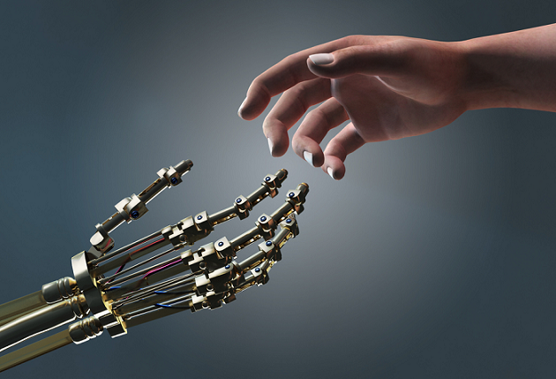
Transhumanism and Posthumanism
Transhumanism: the belief or theory that the human race can evolve beyond its current physical and mental limitations, especially by means of science and technology.
According to transhumanist thinkers, a posthuman is a hypothetical future being "whose basic capacities so radically exceed those of present humans as to be no longer unambiguously human by our current standards.“
However true Christian transhumanism is found when we receive our eternal and spiritual bodies at the resurrection which is our hope of going “beyond this mortal flesh”

Slide 22
People As Products
People are no longer Creations, they are products: products of heredity and environment, of the military, of the education system, of a certain college, of a set of traumatic experiences or certain set of privileges and so on.
Products can be improved, tested for quality and modified
Products are bought and sold in the Market for a value
They also have a shelf-life and can be discarded
Inferior product lines can be terminated.
There is no intrinsic value in a product e,g. how valuable is an iPad 2 today? This is a total contradiction of the gospel…..

Slide 23

Rescuing The Image of God
Humanity was created as incarnate spiritual beings in the image and likeness of God with enduring and eternal personal qualities and a with a deep need for justice.
The image of God will be fully revealed in us at the resurrection, at the “revealing of the sons of God” when we will “be like Him”. True transcendence comes through faith in Jesus Christ!
Ultimately technology will be shown as a futile hope.
Christian ministry needs to focus on developing the image of God in people and not on “producing results” or products.

Slide 24

Finding The Real God
And I saw another angel flying in mid-heaven, having the everlasting gospel to preach to those dwelling on the earth, even to every nation and kindred and tongue and people, saying with a great voice, Fear God and give glory to Him! For the hour of His judgment has come. And worship Him who made the heaven and the earth, and the sea, and the fountains of waters. And another angel followed, saying, The great city, Babylon, has fallen, has fallen; because of the wine of the anger of her fornication; she has made all nations to drink.
(Revelation 14:6-8)

Slide 25
No More Priests
Technology is forcing the human spirit towards an unquenchable thirst for direct personal communication with God.
We are longing for something far beyond magic, ritual or even doctrine.
We can only find a solution to our alienation through the powerful personal presence of God in Christ, through the Holy Spirit.

Slide 26

More Theology of Technology?
Masters in Science, Technology, Society and Ministry at CityVision College in Boston (online program)
www.cityvision.edu/mstsm/
Focused on Theology of Technology, New Media, Internet Evangelism & Mobile etc

Slide 27

Globalchristians.org
Cybermissions.org
NewTestamentPrayer.com
BiblicalEQ.com
@Cybermissions
John Edmiston – CEO
Theology of Technology
Emotional Intelligence And Digital Culture
E-Learning , Appropriate Technology, Internet Evangelism, Mobile
johned@cybermissions.org +1-310-748-9274

