Slide 1

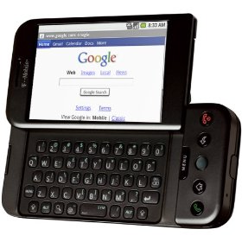

Mobile Ministry Technology
By John Edmiston,
feel free to distribute this PowerPoint presentation unaltered to your ministry friends but it must not be sold in any way.
Mobile Ministry Technology

Slide 2

The Statistics http://mobithinking.com/mobile-marketing-tools/latest-mobile-stats
Over 6 billion mobile phone accounts
Over 1 Billion smartphone accounts (18%)
76% of the global population have mobile phones
68% of even developing nations population
6.1 TRILLION text messages sent in 2010
Many mobile Web users are mobile-only, i.e. they do not, or very rarely use a desktop, laptop or tablet to access the Web. In Egypt and India this is 70 percent and 59 percent of mobile Web users are mobile-only. Even in the US it’s 25 percent. over 85 percent of new handsets will be able to access the mobile Web. Please note that this does not mean smartphones – you do not need a smartphone to access the mobile Web (but it does make for a richer experience).

Slide 3
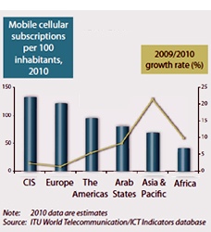
Who Is Going Mobile?
China and India between them added 300 million mobile phone subscriptions in 2010! (more that the total subscribers in the USA)

Slide 4
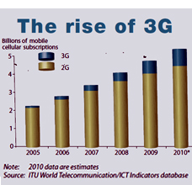
3G

Slide 5

What Is Mobile Ministry?
Technically anything less than a five inch screen….
Mobile phones, smartphones, iPods,
Some include tablet devices and even e-readers
Basically ministry on a highly portable personal computing device
Many of these devices are now Internet capable and have some reasonable processing power
Storage via SD cards is commonly up to 32GB
Can now handle a wide variety of media and various formats.

Slide 6
Advantages For Ministry
Highly persuasive medium (B.J. Fogg, Stanford U.)
Personal
Ubiquitous
Allows privacy of viewing
Responsive (can SMS a reply etc)
Combines text, audio, video capabilities
Can store large amounts of data on micro-SDHC cards
Can act as a broadcast medium attached to a small speaker or by using “line out” to another device or even w. projector phones.
Are rapidly improving in their capabilities
They already have the device we just have to supply the relationships and the data!

Slide 7
Some Ministry Vectors
Text messaging, email/SMS gateways
Short evangelistic video clips
MP3 files, audio bibles, audio resources
I.M / Chat to mobile , Skype on mobiles
Ebooks, PDFs, mobile optimized text resources
.mobi – mobile optimized websites
Bluetooth / nearcasting
Streaming radio / podcasts to mobile
Cell tracts

Slide 8

Starting In Mobile Ministry
Case Studies / Research
www.internetevangelismday.com/mobile-outreach.php - the mobile evangelism page on the Internet Evangelism Day website
http://mobilev.pbwiki.com/FrontPage MobileEV - a mobile evangelism wiki
http://mobileministrymagazine.com/ Mobile Ministry Magazine
Mobile Advance (www.mobileadvance.org)
Mobile Ministry Search Engine www.phronema.org

Slide 9

Mobile Ministry Course
www.cybermissions.org/mobilemin/
Next course in June 26th, enroll after June 11th
4 weeks, $20
Overview of Mobile Ministry Evangelism & Discipleship Training & Discipleship Low Bandwidth (text, audio etc) Training & Discipleship High Bandwidth (video, apps)

Slide 10
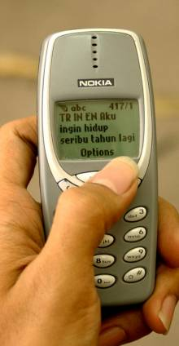
SMS
In the Muslim world SMS messages are the PREFERRED method of responding to the gospel
Text 2 Email gateways are now becoming a critical part of evangelism!
Some crusades have a number you can text to indicate a decision to follow Jesus.
A URL for follow-up can be sent by return SMS
Frontline SMS a solution for non-profits
http://www.greatercalling.org/
www.Clickatell.com
http://en.wikipedia.org/wiki/SMS_gateways

Slide 11
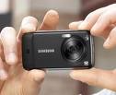
Using Mobiles For Resource Creation
Using a mobile device to capture audio or video for ministry e.g. record a sermon
Record best practices
Record God stories in minority languages
Acceptable video /audio is now possible
Many free editing and file conversion tools e.g. at Sourceforge, Gizmo’s Freeware, MajorGeeks.com etc
Has huge potential for those working in minority languages
Storying / culture acquisition / oral learners

Slide 12
Oral Learners
70% + of the global population are oral learners who strongly prefer not to read
Audio and visual “storying”
www.simplythestory.org
www.visualstorynetwork.org
Large numbers now own mobile devices
How can we create gospel stories / worldview changing stories for them that will work on the mobile platforms that most have access to ?
Short video clips, Audio discussed in a group setting, PowerPoints, animations etc of bible stories suitable for mobile screens

Slide 13
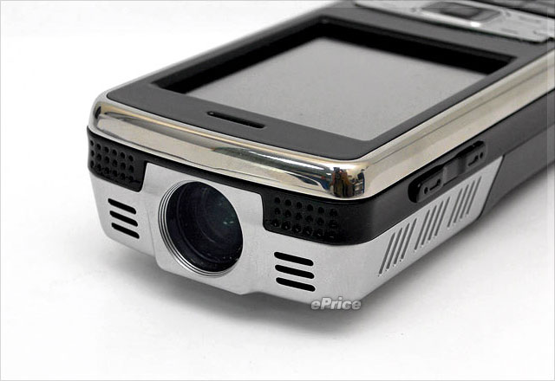
Mobile Education
Portable Moodle (Poodle) – Moodle for USB sticks, mobile devices etc, do not require a LAMP stack on a server
DEScribe & DE-Viewer – DE-Viewer – Distance Education Viewer is a simple LMS (learning management system) and DE-Scribe helps you prepare courses for De-Viewer
MAF-LT (Learning Technologies)
Projector phones for itinerant bible teachers w. video content on SD cards
Audio via speakerphone or a small plug-in speaker

Slide 14

Cell Church / Home Church
New works and works in creative access nations often depend on house churches
Resourcing them and keeping them theologically on-track can be a problem
Equip leaders with cellphones w. amplification devices / speakers and MP3 resources via web or SD cards.
Can train 12-25 people, portable and not so obvious
Leader downloads material from repository to their mobile device then plays to their group
For instance listen to an audio bible in their language then discuss the passages / stories using inductive bible study techniques

Slide 15
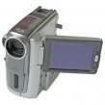
Mobile Video
Simple head and shoulders, not “busy”, simple backgrounds, limited movement because of small screen size
Brief is better (few will watch a 90 minute movie on an iPod)
PowerPoint-to-video animations work well
Can add various minority language audio dubbing to the PowerPoint (which is then converted to video) so one good illustrated bible story can serve many people groups.
Can “go viral” and be passed around by BlueTooth

Slide 16
Audio For Mobile
Can go down to 16kbps /11,025Hz for voice only e.g. preaching downloads for low-bandwidth areas or for distribution of large amounts of resources on SD cards.
Audio is the only one-to-many option (one mobile to many listeners) cannot do that w. text or video, only 1 or 2 can watch a video on a normal phone
Indigenized / contextualized audio for mobile a huge area of potential ministry
FM to mobile and (possibly) short-wave via DRM chips (Digital Radio Mondial)

Slide 17

Nearcasting
Using Bluetooth to share mobile content
Works well in sharing pre-evangelistic video clips in some restricted access countries where Bluetooth is common and accepted socially
Has the ability to “go viral”
A bit like passing out tracts but cooler and less confrontational

Slide 18
Converting for Mobile (free tools)
Format Factory (convert audio & video to various mobile formats)
FFCoder (for the heavy lifting, tweaking and converting audio & video)
SUPER audio and video converter (MajorGeeks pick)
NEXT Video Converter
MobiPocket Creator (mobile ebooks etc)
Calibre Ebook Creator (frequently updated so v. good)
Audacity – high quality, free audio editing and file conversion software
Ispring converter (PPT to Flash)
OpenOffice.Org (PPT to Flash can be done w/in OO)

Slide 19

Apps
SwebApps
http://www.redfoundry.com/
BuzzTouch – free mobile app builder for iphone & Android
http://en.wikipedia.org/wiki/Mobile_application_development
Building Android apps
Android developers guide
W3schools
How to create an iPhone web app
http://en.wikipedia.org/wiki/List_of_digital_distribution_platforms_for_mobile_devices
http://en.wikipedia.org/wiki/Mobile_app

Slide 20

More Apps Stuff
Sencha AJAX Tool Suites
http://www.sencha.com/
Sencha Touch - Mobile AJAX
http://www.sencha.com/products/touch/
jQuery Touch (Mobile for jQuery AJAX)
http://www.jqtouch.com/
PhoneGap - Compiles mobile AJAX apps to 9 mobile platforms
Support mulitple AJAX libraries including Sencha Touch
http://www.phonegap.com/
PhoneGap - mobile device supported features
http://www.phonegap.com/about/features
Thanks to Tony O’Hagan for these links..

Slide 21

The Last Mile…
CHALLENGE: How to get training out to isolated rural learners and to Christian leaders in the new massive urban slums?
The mobile phone is one of the few viable delivery platforms
50-70% penetration rate even in Africa
Most will not have 3G data plans so we have to be creative
Need to combine the delivery mechanism (mobile) with small groups / mentoring / a respected discipler of people

Slide 22
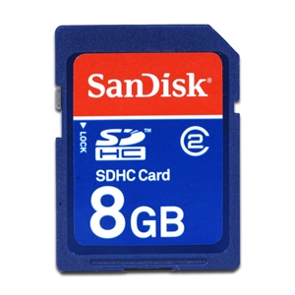
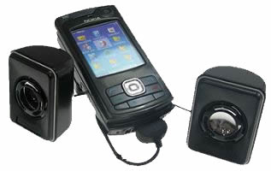
The Mobile Bible College
Curriculum on an SDHC card
A mobile phone + speakers
Does not need reliable electricity
Does not require Internet access
Portable, secure and looks normal
Can train up to 25 people
Useful for house churches
Works with most types of phones
SDHC cards: 8Gb will hold up to 500+ hours of reasonable quality audio
30 hrs lecturing = one bible college subject (with some class discussion of the material)
So therefore 500 hrs = 16 subjects = 4 semesters of 4 subjects = 2 year course on a fingernail-sized chip

Slide 23
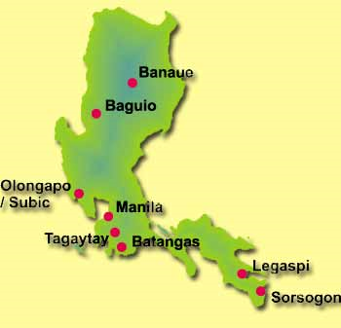
In Luzon
200+ pastors in a network
Use to learn Christology and apologetics to refute Muslims and a local cult (Iglesia Ni Cristo)
Ten minute segments
Scenario based learning
Discuss scenario in groups
Short quizzes
Emphasis on changing behavior
Both audio and video
Also a PDF textbook
Train facilitators who then train others.

Slide 24
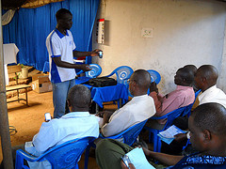
Other Models
A mobile learning app: http://Allogy.com
Contains all the audio, video and text needed for a course, quizzes by SMS, final assessment pen and paper. Learn at own pace.
The app as used in Africa http://technology.ccci.org/projects/the-mlearning-project/

Slide 25
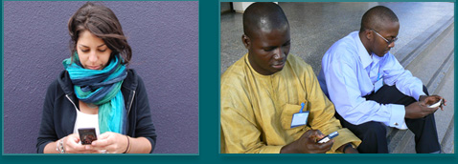
Using SMS To…..
Make or follow-up a decision for Christ
Ask life-changing questions
Get student feedback
Indicate “homework” to be done
Send brief content such as bible verses
6 brief messages a day can start changing someone’s life..
Gammu SMS gateway (free)
Text Magic (email to SMS)
Frontline SMS (SMS to a large group of people anywhere there is a mobile signal)

Slide 26
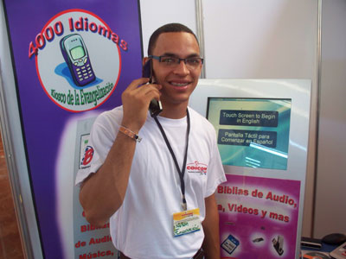
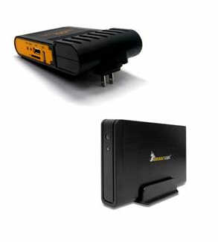
Mobile Evangelism Kiosks
Model A) Physical kiosk with SD card duplication capabilities
Model B) A 2TB HDD loaded with content plus a PlugPC and wireless router so gospel can be downloaded directly to phones. Highly mobile, does not require an Internet connection, can even be used on buses etc.
Audio bibles in numerous languages as well as key teaching materials - http://www.kioskevangelism.com/
Being developed by Stephen Keel in Virginia with assistance from Lightsys, MAF-LT, ICCM, GRN, and Cybermissions

Slide 27


Orality
Use mobile phones to reach oral learners – up to 70% of the population are primarly oral learners
Put audio bibles on SDHC cards or on .mobi websites
Listen to the bible stories in a group (using a mobile phone w. speakers etc.) and discuss.
Use with Way of Righteousness and other oral storying materials being developed
http://www.visualstorynetwork.org/

Slide 28
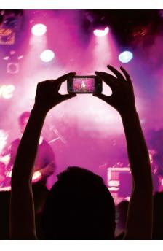
Creating Contextualized Content
Collect indigenous Christian music, sermons, teaching and stories using mobile phone video and audio recording and note-taking capabilities
Upload to a website or online repository, add metadata then make searchable
Duplicate collections (say in a particular language) e.g. on SD cards
Share via Bluetooth

Slide 29

Best Practices Mobile Media
Mobile Media Best Practices Working Document (in-process)- http://bit.ly/hKtyZ1
Shooting & Producing Good Video (General)- http://www.mobileadvance.org/how-to/84-how-to-3-producing-great-video-four-free-video-based-sites-that-will-get-you-there
Media for the Mobile Screen Best Practices- http://www.mobileadvance.org/how-to/88-how-to-4-top-10-mobile-video-production-tips
Shooting Good Video with a Mobile Phone- http://www.mobileadvance.org/how-to/96-how-to-5-shooting-good-video-with-a-mobile-phone
The above links are courtesy of MobileAdvance.Org

Slide 30

Course Design 1 – B4 U Start
Who: Are you trying to teach?
Who: Are they connected to?
Where: Are they? Bandwidth? Phones?
When: Time constraints & opportunities
What: Are their learning needs?
What: Are their felt needs?
What: Technology is available & easy?
How: Do they learn best?
How: Can they use the materials?
How: Can you tell if learning occurred?
How: Can you get feedback?
Why: Is there a real need or is it just cool?

Slide 31

Course Design 2 - Delivery
Smartphone App – high end users with 3g connections
SD Cards – basic feature phones, most computers and tablets
Wireless – many feature phones, laptops, ipods, tablets.
Bluetooth – limited range and file size, more advanced phones
Mobile website – feature phones and smartphones but cost of downloading materials may be high
Asterix audio call2phone – calls the phones or phones call Asterix server
Skype / conferencing – for phones w. Skype.

Slide 32
Course Design 3 – Choosing Media
Audio – universal, easy to make
Video – high cost of production
Ebook – needs to be a supported format on the phones, PDF on most
SMS – great for feedback
Story and Reflect – oral learners
Blended - have media on phone discuss in face-to-face group

Slide 33

Course Design 4 – Training Intervals
Shorter is better
No one wants to watch a 45 minute sermon on a 2 inch screen.
Ten minute “chunks” then reflect, feedback, SMS quiz etc.
Simple interface, not busy
Use scenarios that teach lessons create questions - like some management training videos
Interrupt-able – no devastating loss of info if the person has to glance away for a second.

Slide 34

CONTACT
John Edmiston, CEO Cybermissions
johned@aibi.ph
http://www.cybermissions.org/
facebook.com/johnedmiston/
Twitter: @Cybermissions

