Slide 1

Cybermissions and the Unreached

Slide 2
This presentation will demonstrate how to use technology to achieve Kingdom purposes among the Unreached

Slide 3

The first touch is often a digital touch!

Slide 4
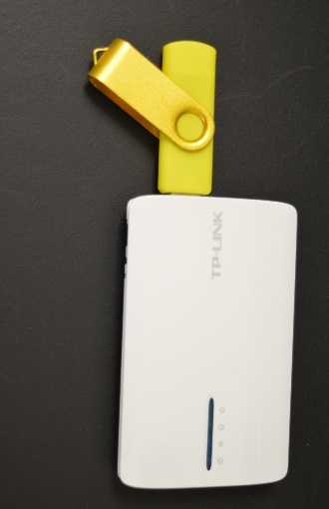
The Advantages of Cybermissions
Global reach at an affordable cost
The ubiquity of technology and its trusted place in modern global lifestyles
No visas required, low physical security risks
Can deploy virtual teams with multiple geographic locations, ages, skills, health levels and lifestyles.
Tends to only contact inquirers who are already somewhat interested, those who have found a website via a search say in Bing or Google..
Can be easily directed toward a particular interest group, ethnic group or language group

Slide 5

Online You Can….
Get saved on a Christian website
Get discipled via Skype
Go to church in an e-church or via streaming
Find great sermons & worship music
Do your ministry degree
Meet a Christian wife/husband
Get ordained and become a Reverend
Start an online ministry & get 501c3 status for it
Write a print-on-demand book and also get it on Kindle and become famous….
Send money to orphans in Africa by Paypal
Have an online bible college and issue diplomas

Slide 6

The Digital Pathway Works When….
You are very isolated, elderly or disabled
You are being persecuted
You are in a Creative Access Nation
You cannot afford brick and mortar structures
You are highly literate and computer savvy
You feel that you do not belong in Church
The Church in your area is apostate / in error

Slide 7

The Only Open Door…
In North Africa and the Middle East the digital pathway may be the ONLY pathway to Christ.
You cannot ask believers to publicly “walk the sawdust trail”.
Social media and satellite TV are the main means that Muslims turn to Christ in many counties.
We need to keep this door open!

Slide 8

Where Do They Study?
In most parts of the developing world there are very few good bible colleges
However Christians can read ebooks and articles, study courses, watch videos and listen to MP3 files on their tablets, computers and smartphones.
They can access the best teaching around the world this way.
It is quite inexpensive to deliver

Slide 9

Big Ideas
The digital pathway may soon become the majority pathway in the Majority World.
It will soon deliver the vast bulk of grassroots theological education.
Already people converted online are being channeled into bible study groups and churches.
Church-planting now begins with a digital touch!

Slide 10
Information Is Digital
Impartation Is Spiritual
Formation Is Personal
Transformation Is Communal

Slide 11
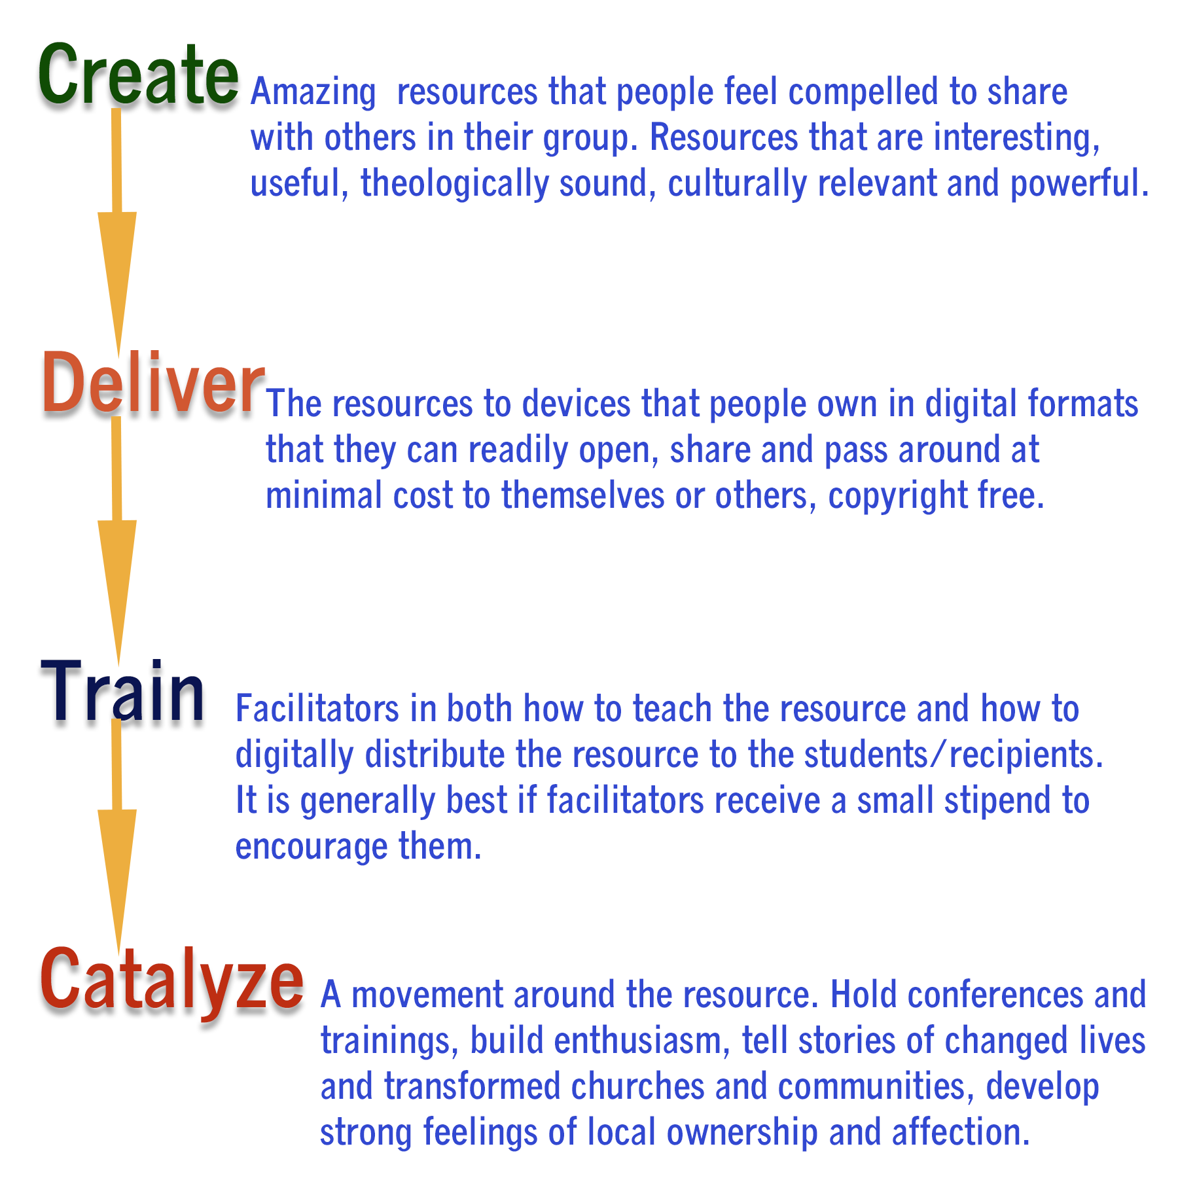

Slide 12
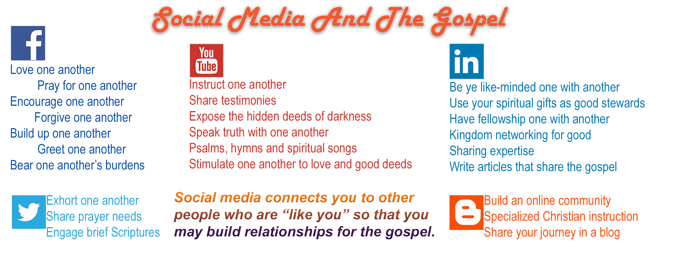

Slide 13
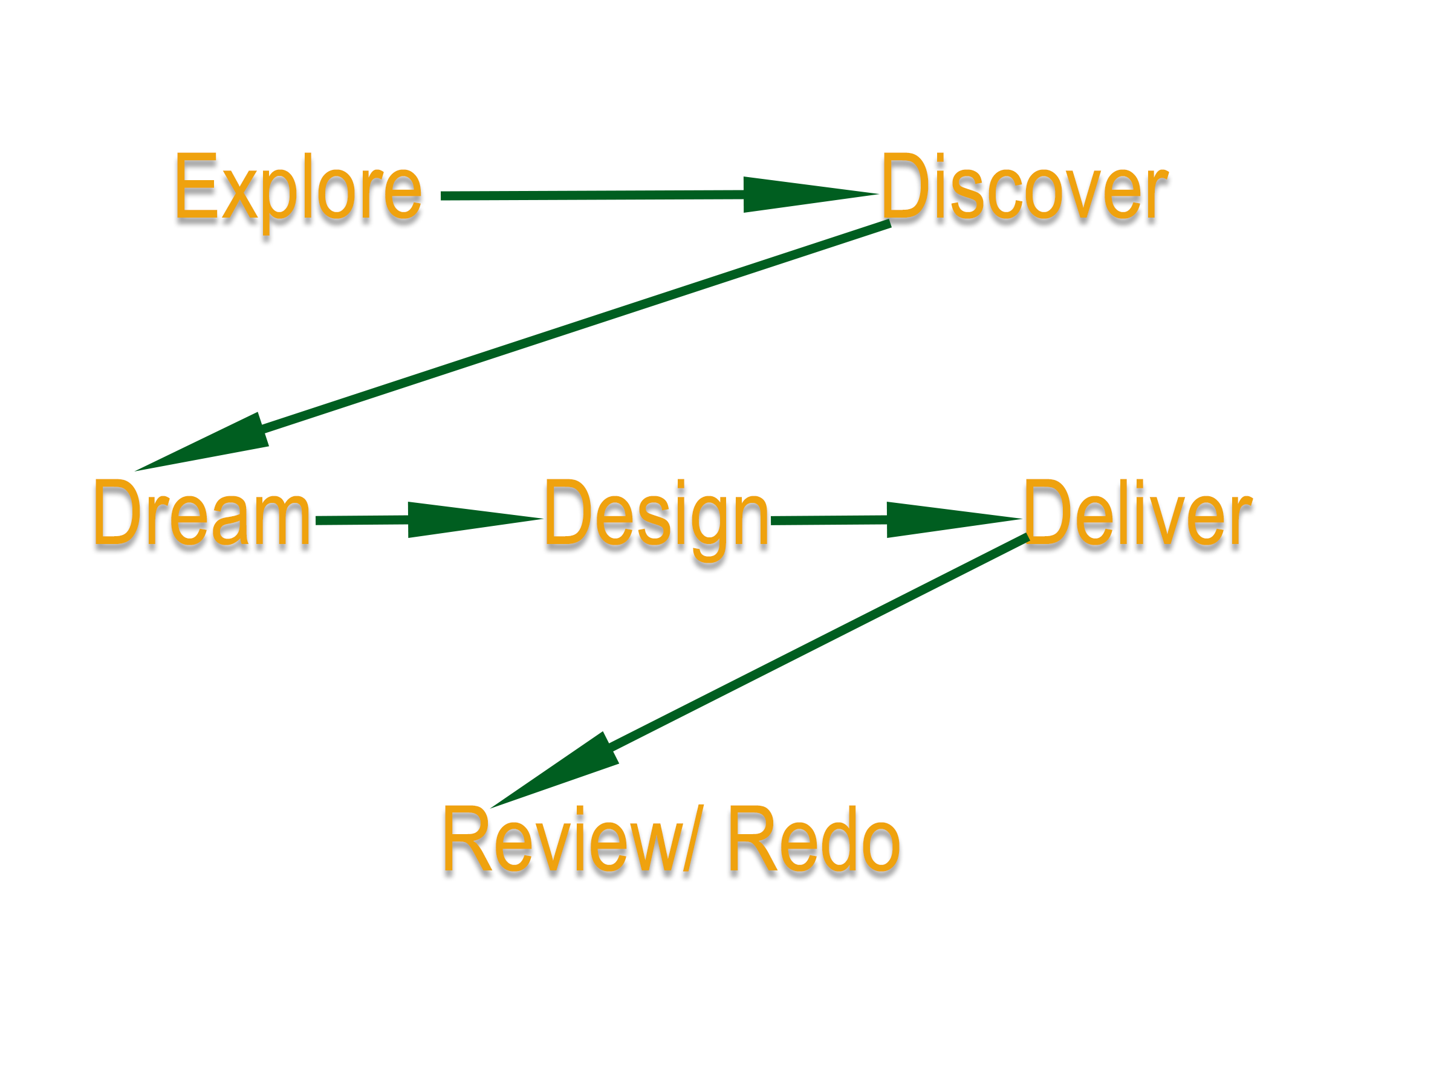

Slide 14

There is an incredible array of options for technology-enabled Christian ministry so we are continually on a quest to EXPLORE what is out there and then to DISCOVER what will work best for us!

Slide 15
The Bicultural Principle Online…
Paul (Hebrew & Greek)
Barnabas and Mark
(Hebrew/ Cypriot)
Cyprus
Silas (Hebrew/ Dalmatian)
Timothy (Hebrew/Greek)
Dalmatia
Ephesus
Recruit people who speak a major Internet language (English, Spanish, Chinese etc) and who also have second and third cultures, to reach those less-known cultures by digital means.

Slide 16
Communities of Delivery…
Master Repository Level – centralized collection / library, meta-tagged, multiple languages legal and copyright issues are the main challenge.
National Level – large collections, materials selected by national level leaders, cultural relevance important
People Group Level – language groups, contextualized
Denominational / Large Network – theological groups and affinity groups, careful about heresy & suitability
Association / Clergy Conference – colleagues, leaders
Local Church / House Church – grass roots

Slide 17
Technology For Each Level…
Master Repository Level – 10TB+ databases, searchable, meta-tagged, able to create national level collections from the Master Repository,
National Level – 1-2TB databases, ability to create relevant training media from this collection
People Group Level –Internet/ satellite, viral media, video, language specific resources
Denominational / Large Network – large website, digital library, DVD collections
Association / Clergy Conference – USB, DVD, wireless hotspot, SD cards
Local Church / House Church – Bluetooth, USB drives, email attachments, church website, MP3 players etc

Slide 18

Orality & Mobile
Up to 70% of the population are primarly oral learners and many/most have mobile phones.
Audio bible and key MP3 resources
Brief video clips
Podcasts in MP3 format, very powerful for leadership development. Used while driving etc.
MP3 is easier to download and more private (can listen with earbuds)
Listen to the bible stories in a group (using a mobile phone w. speakers etc.) and discuss.

Slide 19

Creating Contextualized Content
Collect indigenous Christian music, sermons, teaching and stories using mobile phone video and audio recording and note-taking capabilities
Upload to a website or online repository, add metadata then make searchable
Duplicate collections (say in a particular language) e.g. on SD cards
Share via Bluetooth

Slide 20

Technology Imperatives
Interactive
Participative
Experiential
Device to Device (cellphones, tablets, devices of all sorts..)
Non-literate – verbal / audio
Brief & Compressed
Holistic
Tagged / RSS / Metadata
Multiple languages & cultures
Multiple bandwidth versions

Slide 21

Design
Internationalize
Clarity
Reduce idiomatic expressions
Be hopeful and aspirational
Explain, explain, explain….
Offer a helpful handshake and minimize confusion and distraction.

Slide 22

Attitudes
Scripture rather than culture
Spirit rather than method
Compassion rather than just content
Trustful connection rather than just ‘customer service’
‘Come into our community’ rather than just ‘pray the prayer and go away please’
Engaged with the whole of life rather than cerebral, engaged with a ‘bunch of concepts’

Slide 23

Love Newbies!
If the user is made to feel dumb they just go away
If their problems are ignored they will resent you
But if people feel they are helped quickly they will become loyal
If the user feels empowered they build enthusiasm
If a user feels ‘’hey I am cool I can do this’ they build pride and tell others

Slide 24

Local Networks
Develop in-country networks
Cultivate local leaders
Pay for translation, use locals, use the translation process to build relationships
Give people an aspirational career pathway within your online ministry
Volunteer – Senior Volunteer – Part-Time Paid – Full-Time Paid
Delegate real authority and the right to contextualize your ministry

Slide 25

Be First To Market
Be first to ‘market’ – be one of the first in a particular language group
This gives you great prestige and influence
It also introduces you to early adopters and to leaders in that culture
Partner with missions agencies and churches overseas

Slide 26

Digital Ministry Training Course
www.Cybermissions.org/moodle/
An new online course designed for people busy in ministry, only $50, payable by Paypal. An in-service, in-context course.
Basic digital ministry strategies, digital content creation, digital content distribution, mobile ministry, social media, SEO and conversion funnels.
Zero stress, self-paced, absolutely no writing, mainly visual presentations, no social stress, easy to do in your own time at your own pace. Start anytime, finish anytime. About 4 hours per week.
Launches on Monday, April 3rd 2017! But you can start anytime

Slide 27


Contact Information
johned@cybermissions.org
Twitter: @Cybermissions Skype: johnedmiston
21615 Berendo Ave. Ste 400Torrance CA 90502
Ph: 310-844-6948 Mob: 310-748-9274
Cybermissions.org, GlobalChristians.org, BiblicalEQ.com,
NewTestamentPrayer.com, Phronema.Org,

