Slide 1

Digital Resources & Gospel Movements

Slide 2

Rapidly multiplying gospel movements are often under-resourced:
a) theologically and
b) in leadership training.
This can lead to serious problems in the fourth and fifth generations of a church-planting movement e.g. heresy, denying the Trinity, prosperity gospel, syncretism with local cultures and erratic leadership practices.

Slide 3
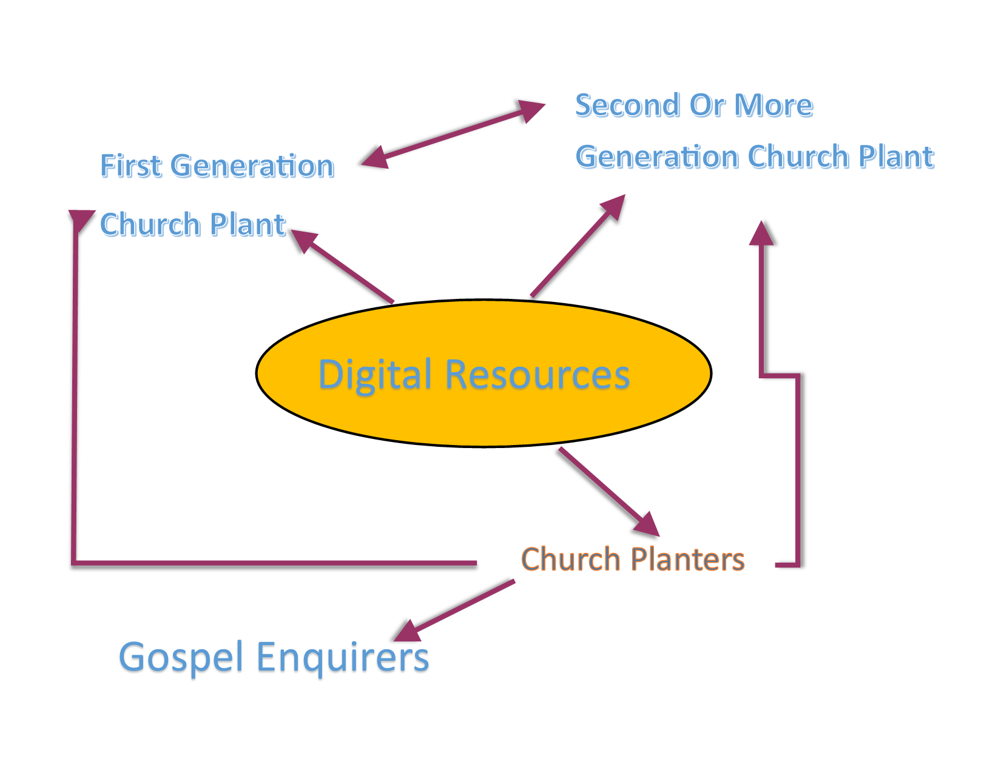

Slide 4
Information Is Digital
Impartation Is Spiritual
Formation Is Personal
Transformation Is Communal

Slide 5

4 Things That Leaders NEED
Accurate Information
The Best Practices In Their Area
Step-by-Step “How To” Methods
Connections To Expertise & Funds
Do not leave them stranded without one or more of these factors!

Slide 6
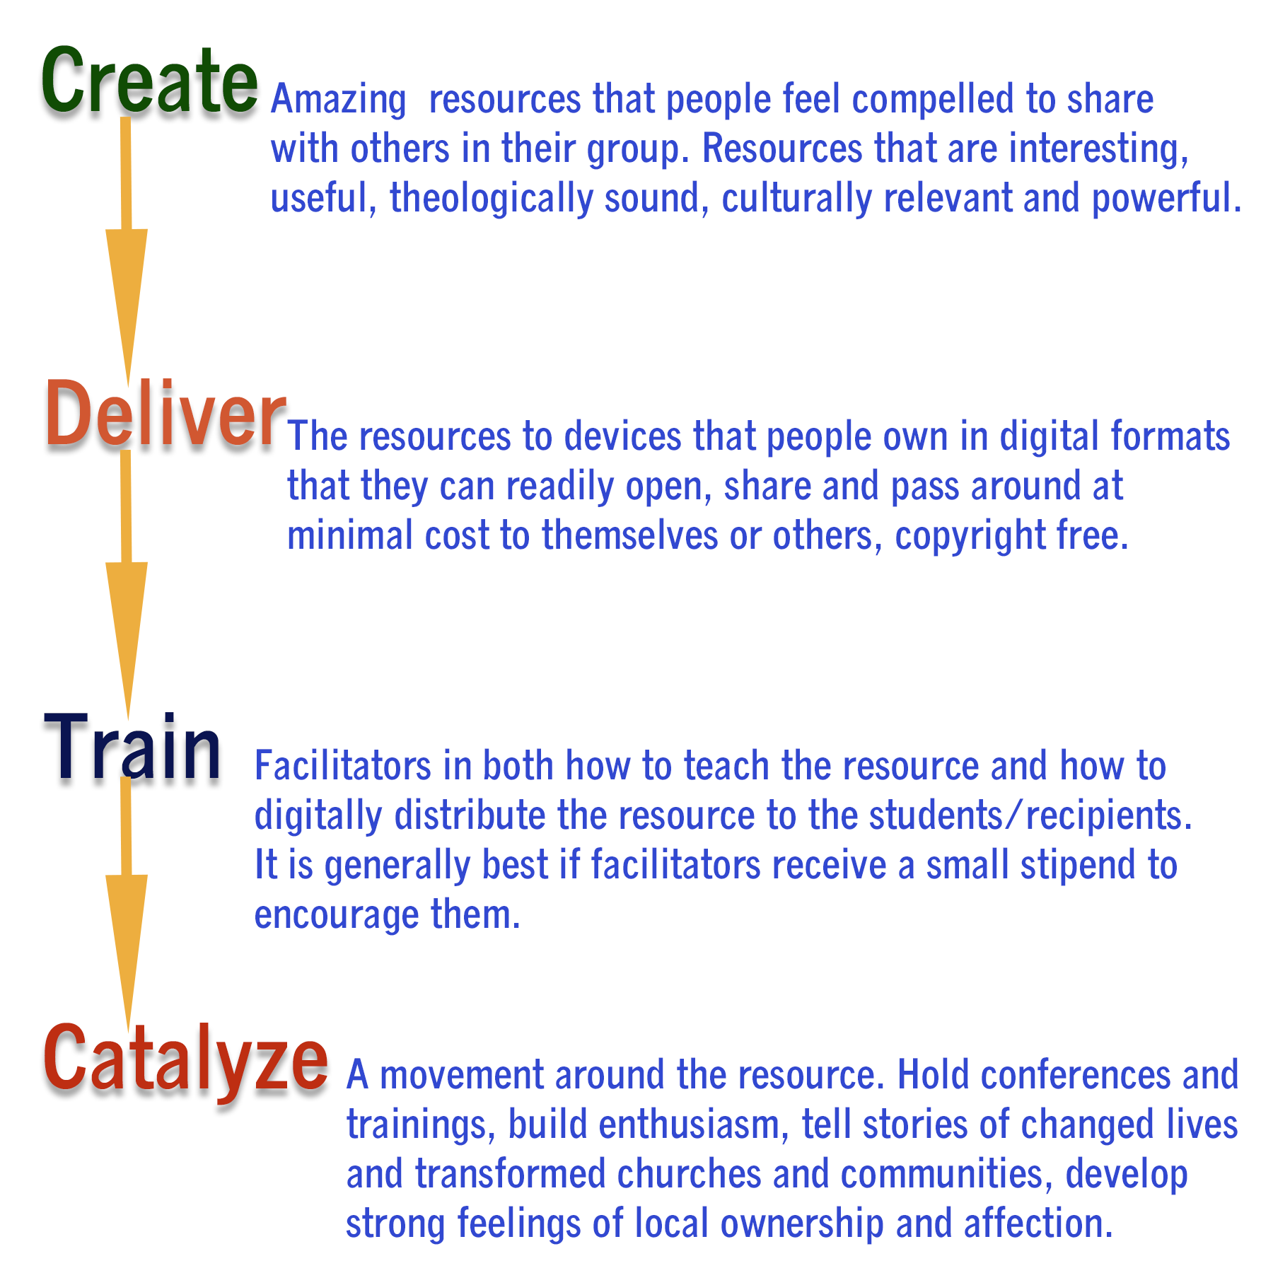

Slide 7
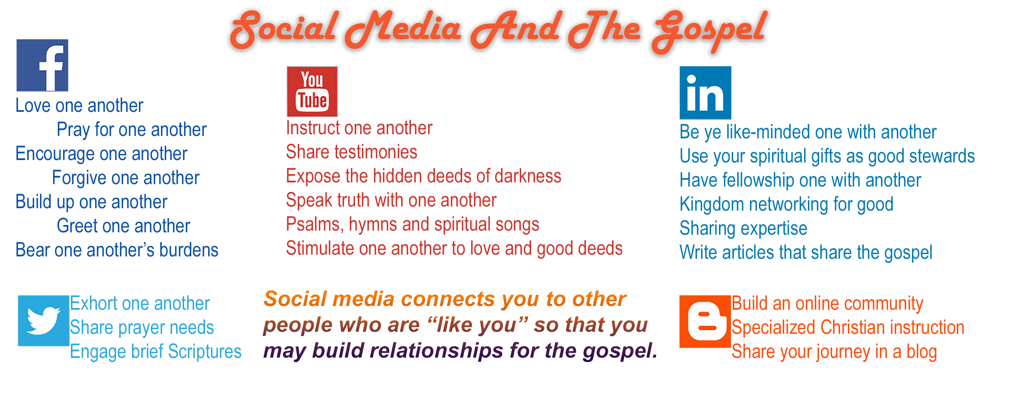

Slide 8

There is an incredible array of options for technology-enabled Christian ministry so we are continually on a quest to EXPLORE what is out there and then to DISCOVER what will work best for us!

Slide 9
The Bicultural Principle Online…
Paul (Hebrew & Greek)
Barnabas and Mark
(Hebrew/ Cypriot)
Cyprus
Silas (Hebrew/ Dalmatian)
Timothy (Hebrew/Greek)
Dalmatia
Ephesus
Recruit people who speak a major Internet language (English, Spanish, Chinese etc) and who also have second and third cultures, to reach those less-known cultures by digital means.

Slide 10
Communities of Delivery…
Master Repository Level – centralized collection / library, meta-tagged, multiple languages legal and copyright issues are the main challenge.
National Level – large collections, materials selected by national level leaders, cultural relevance important
People Group Level – language groups, contextualized
Denominational / Large Network – theological groups and affinity groups, careful about heresy & suitability
Association / Clergy Conference – colleagues, leaders
Local Church / House Church – grass roots

Slide 11
Technology For Each Level…
Master Repository Level – 10TB+ databases, searchable, meta-tagged, able to create national level collections from the Master Repository,
National Level – 1-2TB databases, ability to create relevant training media from this collection
People Group Level –Internet/ satellite, viral media, video, language specific resources
Denominational / Large Network – large website, digital library, DVD collections
Association / Clergy Conference – USB, DVD, wireless hotspot, SD cards
Local Church / House Church – Bluetooth, USB drives, email attachments, church website, MP3 players etc

Slide 12

Orality & Mobile
Up to 70% of the population are primarly oral learners and many/most have mobile phones.
Audio bible and key MP3 resources
Brief video clips
Podcasts in MP3 format, very powerful for leadership development. Used while driving etc.
MP3 is easier to download and more private (can listen with earbuds)
Listen to the bible stories in a group (using a mobile phone w. speakers etc.) and discuss.

Slide 13

Technology Imperatives
Interactive
Participative
Experiential
Device to Device (cellphones, tablets, devices of all sorts..)
Non-literate – verbal / audio
Brief & Compressed
Holistic
Tagged / RSS / Metadata
Multiple languages & cultures
Multiple bandwidth versions

Slide 14

Design
Internationalize
Clarity
Reduce idiomatic expressions
Be hopeful and aspirational
Explain, explain, explain….
Offer a helpful handshake and minimize confusion and distraction.

Slide 15

Attitudes
Scripture rather than culture
Spirit rather than method
Compassion rather than just content
Trustful connection rather than just ‘customer service’
‘Come into our community’ rather than just ‘pray the prayer and go away please’
Engaged with the whole of life rather than cerebral, engaged with a ‘bunch of concepts’

Slide 16

Love Newbies!
If the user is made to feel dumb they just go away
If their problems are ignored they will resent you
But if people feel they are helped quickly they will become loyal
If the user feels empowered they build enthusiasm
If a user feels ‘’hey I am cool I can do this’ they build pride and tell others

Slide 17

Local Networks
Develop in-country networks
Cultivate local leaders
Pay for translation, use locals, use the translation process to build relationships
Give people an aspirational career pathway within your online ministry
Volunteer – Senior Volunteer – Part-Time Paid – Full-Time Paid
Delegate real authority and the right to contextualize your ministry

Slide 18

Digital Ministry Training Course
www.Cybermissions.org/moodle/
An new online course designed for people busy in ministry, only $50, payable by Paypal. An in-service, in-context course.
Basic digital ministry strategies, digital content creation, digital content distribution, mobile ministry, social media, SEO and conversion funnels.
Zero stress, self-paced, absolutely no writing, mainly visual presentations, no social stress, easy to do in your own time at your own pace. Start anytime, finish anytime. About 4 hours per week.
Launches on Monday, April 3rd 2017! But you can start anytime

Slide 19


Contact Information
johned@cybermissions.org
Twitter: @Cybermissions Skype: johnedmiston
21615 Berendo Ave. Ste 400Torrance CA 90502
Ph: 310-844-6948 Mob: 310-748-9274
Cybermissions.org, GlobalChristians.org, BiblicalEQ.com,
NewTestamentPrayer.com, Phronema.Org,

