Slide 1
Mobile Apps For Missions
ICCM 2014

Slide 2
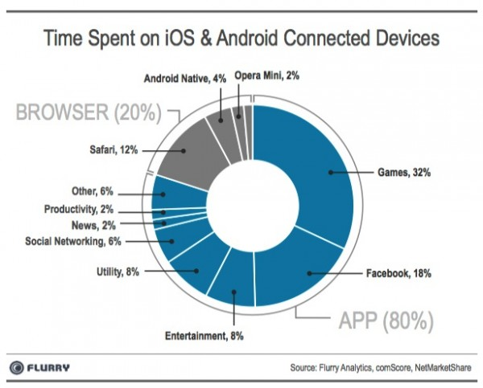
Phone Statistics
83% of time on smartphones is spent using apps
50% is spent on just games and Facebook

Slide 3
The Rise of Smartphones
Smartphones showed 20% growth in 2013
30% of phone shipped globally are smartphones
Growth is strongest in developing nations such as China, India, Russia and Brazil
Inexpensive Tizen and other smartphones from China will soon be available.
The cost of data plans is still a problem but some apps (e.g. games) do not need much data.

Slide 4
Common Missions Tasks
Education: Lumin, Estante, Moodle and other LMS systems as apps
Proclamation: Jesus Film apps, GRN app, Faith Comes by Hearing
Utilities and Security: a wide range of encryption tools, FTP apps etc
Productivity: Evernote, Google Drive etc

Slide 5
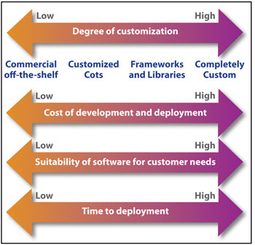
Buy vs. Build
Should you:
Use a free app?
Buy a commercial app?
Buy and modify ?
Build your own app?

Slide 6
When To Build…
If you need it to be totally secure without any possible backdoors.
If branding is a critical issue for you
When you can absolutely guarantee that you can still support it in five years time.
When you have done the research and no commercial app meets even 40% of your needs.
When the development cost is trivial e.g. some web apps.

Slide 7
Understanding Your Requirements
A requirements statement is a complete list of all the features that you want in the app:
Absolutely Essential: these are core features that the app MUST have e.g. “works under Android” or “is secure in Saudi Arabia”
Highly Desirable: Almost essential, should be included if at all possible, an app with these features is preferred e.g. “backwards compatible with..”
Desirable Extras: You would like these features but they are not super-essential e.g. “comes in purple”.
Hammering out a very complete requirements statement and will save you large amounts of time, money and frustration.

Slide 8

Development Roadmap
Sketch out a development roadmap
Set timelines for the various stages
Do a pilot test
Ask for user feedback
How urgent is urgent?

Slide 9
Where Is Your Talent?
In-House – you already have a great team of app developers
An outside app development agency
A large known commercial vendor
An unknown free app developer
Fred the cool guy at church

Slide 10
Can A Commercial App Do 60%-80% Of What You Need?
Is it easier to train your staff in a commercial app that does 60-80% of the job and which can be deployed immediately?
Can you combine two free apps to get the results that you desire?
Are the extra features you get with a well built app worth the time and money that will be spent on it?
Are your IT staff better at helpdesk and at adapting a commercial app or are they better at programming a totally new app?

Slide 11
Cross-Platform Issues
Developing complex native apps for multiple platforms is often quite difficult.
If your mission is BYOD (bring your own device) and you need the app to work on everything from Blackberrys to iPhones, Android, Kindle Fire and Symbian and Windows Phone then “buy” is probably going to be the best option
Unless your app is very simple and does not need direct access to features on the device such as a HTML5 app

Slide 12

Security Issues
On one hand by building your own app you can secure it and stop any “backdoors”
On the other hand security issues and threat vectors change quickly and you will need to keep updating the software which means paying a full-time, in-house app developer who understands security very deeply.
A good commercial app vendor will do this automatically.

Slide 13

Support Issues
Once you have built the app can you support it?
What happens if the lead developer “drops dead” or leaves your organization?
Can it be supported 24/7 across multiple time zones (essential for critical apps)
Can you supply support in all the necessary languages? Can a vendor supply this support?

Slide 14

Researching Apps
Try appszoom.com or the various stores such as Google Play, Apps Store etc.
Try multiple key words e.g. learning, teaching, discipleship, school, college, distance education
It does not have to be specifically Christian app
Try a large number of apps (don’t just try three or four) and budget for the testing out of apps.
Also check things such as Salesforce that let you develop your own customized app using their hardware.
Do this for at least two weeks.

Slide 15
The Four D’s
Discover – what is out there
Dream – how it can be adapted to your organization’s requirements / used to share the gospel
Design – how can this best be tweaked, improved, or deployed?
Deliver – deliver the app into the field/ organizational environment.

Slide 16

HTML5 Apps From Websites
If all you want to do is turn a website into an app that has a “native app” feel to it you can use a powerful programming language known as HTML5. Two tools that will help you do this are:
Sencha Touch http://www.sencha.com/products/touch/
then use:
PhoneGap to create APIs for multiple mobile platforms http://phonegap.com/

Slide 17

Evernote ($5 a month paid version)
Take notes, including voice notes and photos
Encrypt notes and folders
Create “tags” for your notes
Share notes and folders with colleagues
Photograph a check or whiteboard
To-do lists, integrates well with GTD system
Clip websites, also integrates with Twitter etc.
Search your notes (very sophisticated)
Cross-platform and mobile friendly (excellent for BYOD situations)

Slide 18

Evernote As A Discipleship Tool
http://www.thenerdyteacher.com/p/the-epic-evernote-experiment.html
Each student given an Evernote account
Each topic a shared notebook within Evernote Class Notes, Assignments, Handouts, Stories
No class handouts (everything goes to Evernote)
Can share photos and audio as well
Students automatically log on to Evernote and log out when finished with that day’s lesson.

Slide 19

Google Drive / Google Docs
Google Drive: cross-platform storage on most devices and in the cloud
Google Docs – collaboration on documents and spreadsheets, used widely for distributed team meetings, planning and budgeting.
Gmail and Google Chat: useful for personal communication, non-suspicious, standard
Google Hangout: video conferencing with screen sharing and direct upload to YouTube great for content creation, up to 9 people.

Slide 20

YouTube
Most mobile devices have a YouTube app
Record teaching with Google Hangout,
upload straight to YouTube,
share URL with wider audience via Twitter/FB
Clip YouTube URLs to EverNote
Put URLs in a note in a shared Evernote folder
Include instruction on viewing order
Quick video based instructional course

Slide 21

Google OpenClass
Google plus Pearson (textbook folk) collaborate for develop a free powerful learning management system
http://www.openclass.com/open/home/index
Mobile friendly
New but you can probably get an account especially if you already have a Google Apps account.
Run an individual class or a whole school.
Web based, no special software required

Slide 22

Bible Apps
YouVersion dominates the field with multiple bible and cross-platform capability.
Olive Tree Bible Reader also gets good mentions
App stores have dozens of Bible apps.
Try YouVersion plus Evernote for a great discipleship class! Explore a bible story together for oral learners, use voice recording.
Paste from bible app into Twitter, FB
or an SMS message.

Slide 23

Educational Apps
Edmodo – free learning management system, app, robust, cross-platform, gets good reviews.
Canvas – solid LMS but expensive for large scale deployment. Very mobile friendly.
Blackboard Mobile – helps students access Blackboard from their mobile device.
Khan Academy Player App – for watching Khan Academy videos

Slide 24

Social Media Apps
Twitter
Facebook
Google Plus
Pinterest
Various in-country options
Use to create a following, publicize books and events, communicate with supporters etc
Generally better to create a Christian presence within an established community than to create a separate Christian social media app.

Slide 25

Kindle, ePub, and Ebook Apps
There are an ENORMOUS number of free Christian ebooks out there in Kindle format.
How to find free Christian ebooks online:
http://www.smashwords.com/books/download/179711/1/latest/0/0/how-to-find-free-christian-books-online.pdf
Download free Kindle reader app to any mobile device.
Create ebooks with Calibre Ebook creator
Kindle ebook + YouVersion + Evernote or Google Docs = class materials

Slide 26

Digital Library Apps
MAF Learning Technologies (http://maflt.org/) is continually developing mobile friendly digital asset management tools including a sophisticated and powerful Android app called Estante which is self-updating and works offline.
Ibidem is not an app but is a powerful digital asset management tool also developed by MAF-LT, put your master collection in Ibidem.

Slide 27
Database Apps
Cellica Database – updates your mobile device wirelessly to your desktop database. Say have one desktop database in the church or bible college, then folks with Android devices can update their materials.
Memento Database – seems similar to EverNote and is a catch-all for various work related tasks.
HanDBase Database Manager – professional situation, use say for event management. Can create custom solutions.

Slide 28
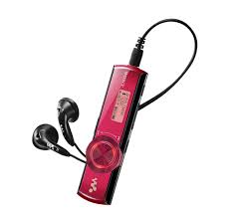
Audio and Video Editing
There are many audio and video editing apps in both the Google Play store and the Apple App Store. I have not used or reviewed them.
Record your training video, sermon, or talk edit on the phone or tablet, share via Bluetooth or on an SD card.
Put audio or video into Estante for future reference.

Slide 29

VOIP Apps
Google Voice
Skype
Viber
Linphone
Whatsapp
iCall
Vippie
Pinger
Check which works best in your area, has the features that you require and is available to your clients/target audience.

Slide 30
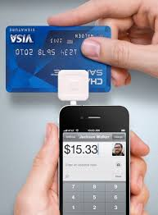
Payment Apps
SquareUp and Square Wallet credit card processing & payments with mobile app and free card reader. This is the best which I have tried.
Paypal credit card reader, payment app and in some cases PayPal mobile app integration
Google Play in-app billing – accept payments in the app (that you designed) itself

Slide 31

Security Apps
TrueCrypt – encrypt the whole or a a portion of your SD card, USB, or HDD, free, powerful useful. EDS Lite is an Android version
Password Managers – LastPass, 1Password, mSecure tend to lead the pack
Malware – AppScan Beta stops malware in apps
Titanium BackupPro (backs up everything)
Advanced Task Killer (stops junk from running)
Avast Antivirus – best antivirus tool for Android also Lookout Mobile Security, McCaffee perform well

Slide 32

Imagination: Combining Apps
Preach – record video with phone – edit with mobile video editing tools- upload to database, Estante or YouTube
Preach – record video into Evernote, edit with audio editing tools, tag, put in shared folder, use for bible class on mobile devices
Develop evangelistic website – turn into HTMl5 app – use app with bible software for follow-up

Slide 33

Imagination 2
Create online course – publicize via Twitter – accept payments using Square – issue student usernames and pwds after payment.
Write ebook in Google Docs – convert to epub using Calibre –upload to Kindle direct Publishing or Smashwords and sell for $2.99 – publicize via social media apps –use as text in online course

Slide 34

Globalchristians.org
Cybermissions.org
NewTestamentPrayer.com
BiblicalEQ.com
@Cybermissions
John Edmiston – CEO
Theology of Technology
Emotional Intelligence And Digital Culture
E-Learning , Appropriate Technology, Internet Evangelism, Mobile
johned@cybermissions.org +1-310-748-9274

