Slide 1

Your Phone Can Be Your Church!

Slide 2

THINK OF ALL THAT TIME!
Consumers are spending 127 minutes per day in mobile apps and spend 168 minutes watching television per day.
(Source: Flurry, 2012)
What if…….
Time on the phone
=
Time at Church?

Slide 3
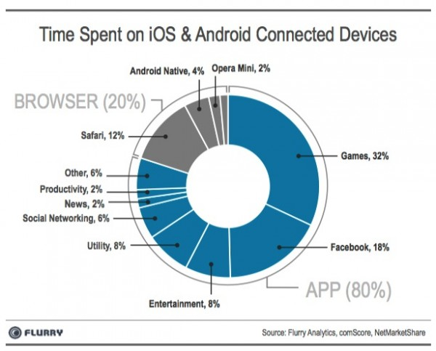
Phone Statistics
3339 texts are received by a US teenager in an average month!
If all the Android phones sold in a single day were stacked up it would equal 327 Empire State Buildings

Slide 4

One-Another Commands
Love one another
Pray for one another
Encourage one another
Forgive one another
Build up one another
Greet one another
Bear one another’s burdens

Slide 5

Discipleship Involves Meaningful Interaction!
Appreciation
Gratitude
Instruction
Exhortation
Prayer

Slide 6

Churches Online
Church websites
Church apps
Churches on FB

Slide 7

Bible-Reading Apps
YouVersion
TouchBible
BibleGateway
BlueLetterBible
Touch Bible
Bible.Is (audio)

Slide 8

Prayer Apps
PrayBuzz
Instapray
PocketPrayerPro
Pray!

Slide 9

Praise & Worship
Worship music and videos online
Turn drive-time into worship time
Use Evernote as a personal journal

Slide 10

Listen To Teaching
Audio Bibles at Bible.Is
Christian audio books
MP3 files – FireFighters.Org
TWR360
Use your drive-time!

Slide 11
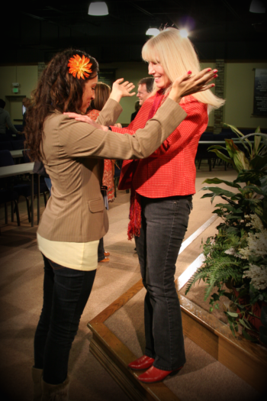
Healing Ministry
MP3 healing prayers – newtestamentprayer.com
Ebooks on healing (Kindle)
Video instructions on healing e.g. on YouTube
Just pray for someone!

Slide 12
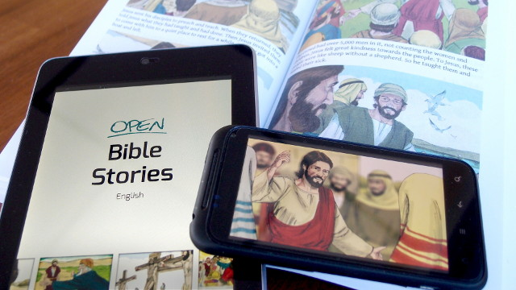
Evangelism Apps
New World Gospel Presentation (IVCF)
GodTools
5Fish.mobi
YesHeIs
One-2-One

Slide 13

Mobile Gaming
32% of time on mobile devices is gaming!
How about some decent Christian games for mobile!
Seems to be mainly memory games so far…..

Slide 14

Social Media
Connect with your “tribe”
Share the gospel
Encourage other believers

Slide 15
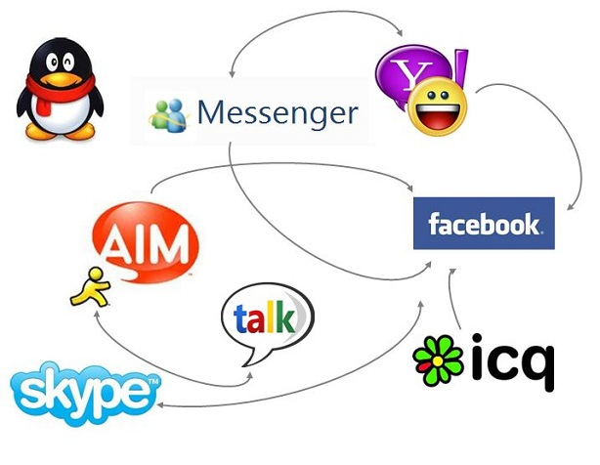
Skype Etc.
“Skypelship”
Meetings
Counseling
Detailed instruction

Slide 16

Christian Courses
Hundreds of online Christian degree programs with good accreditation
Most are “mobile friendly” (better to study on a tablet though)

Slide 17
Priorities!
Jesus or Cat Videos?
Taking Control
Digital Edification

Slide 18
Mobile Church
Think interaction with parishioners
Have a church app
Stream services
MP3 of music and services
Have a prayer text number
Have a mobile or responsive website

Slide 19

Children’s Ministry
Bible game apps
Bible story videos
Child-Safe mobile website

Slide 20

Youth Ministry
Teach youth how to use Christian apps
Expect them to have the Bible on their phone
Engage with them via a text prayer line or event reminder messages YapTap

Slide 21

About Us…
Cybermissions.Org
GlobalChristians.Org
NewTestamentPrayer.com
BiblicalEQ.com
johned@cybermissions.org
+1-310-748-9274
21615 Berendo Ave Ste 400
Torrance CA 90502 (USA)

